Slide 1
Light Energy and its properties
By Joel Bouse
For 7th grade Biology
10/18/2012

Slide 2
What We Will Learn
For this lesson we will learn all about light.
We will learn:
What it is
How we are affected by it
How life is affected by it
How it is manipulated
-Let’s now discuss what you all know about light.

Slide 3
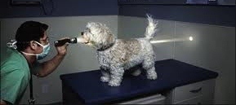
Light Humor
Admit it.
When you were younger you:
Drew the Sun in the corner of the paper.
Closed the fridge door really slow, just to see when the lights went off.
Used a magnifying glass to fry ants.
4) Tried to balance the light switch between the ON & OFF position.
Light is used in many ways;
like in this funny video involving a stoplight-

Slide 4
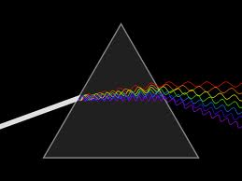
What is Light?
Light is electromagnetic radiation that is visible to the human eye
It is made of waves.
The speed of light is 186,282 miles per second.
Light takes about 8 minutes to reach earth from the Sun.

Slide 5
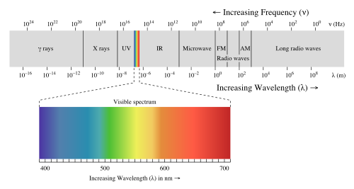
There are many different waves emitted from the Sun like UV rays and x-rays that can’t be seen.
Light is made up of all different colors.
The colors we see are the ones that are being reflected.
A video on electromagnetic waves - YouTube

Slide 6
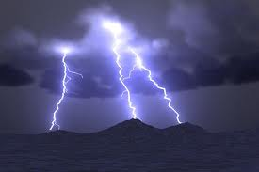
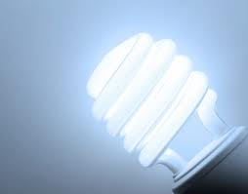
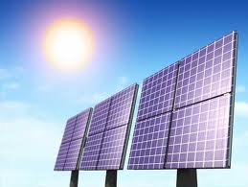
Light is a form of Energy
It can be manipulated and harnessed.

Slide 7
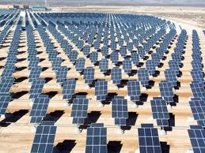
Light of Life
As humans we depend on a steady stream of light energy everyday for many things.
Solar panels harness light energy and converts it into electricity.
This saves billions in costs and helps reduce harmful gas emissions in the environment.

Slide 8
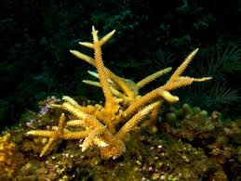
Photosynthesis
Plants
Animals
Plants use light energy as food to live and grow
Some animals, such as corals, also photosynthesize.

Slide 9
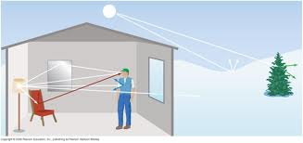
Light Manipulation
As light waves are traveling out from the Sun or any source of light, they run into many objects.
Whenever they hit something, they are either absorbed, reflected, or refracted.

Slide 10
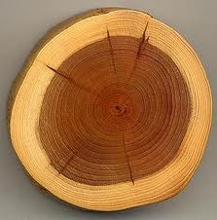
Absorption
When light waves hit an object, they stop and are neither reflected nor refracted.
Example: Wood

Slide 11
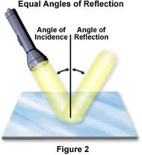
Reflection on a Smooth Surface
When light waves hit a smooth surface they reflect at an angle equal to the angle of the incoming light wave.
Example: Mirror

Slide 12
Reflection on a Rough Surface
When light waves hit rough surfaces, they bounce off at many different angles.
Example: Mountainous Regions

Slide 13
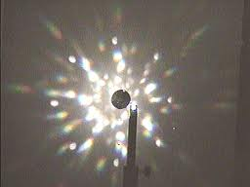
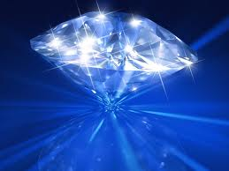
Refraction
When light waves hit certain objects, they go through the object and bend, coming out at different angles.
CPALMS: URL Resource Preview—This will show you how light refracts through different mediums.
Example: Diamond

Slide 14
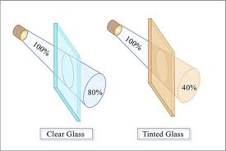
Light Transmission
Sometimes light waves hit objects, they pass through the object but do not bend or change.
This is the transmission of light.

Slide 15
Activity
Now I’m going to name some objects and you guys tell me whether they absorb, reflect, or refract light waves.

